Slide 1


micro:bit entry video tutorial
Lesson 7
micro:bit basic lesson 7 “Dice game”
YahBoom micro:bit video tutorial

Slide 2
micro:bit entry video tutorial
Content
Part1
Part 2
Part3
Part 4
Part 5
Learning goals
Preparation
Search for blocks
Combine blocks
Have a try
YahBoom micro:bit video tutorial

Slide 3
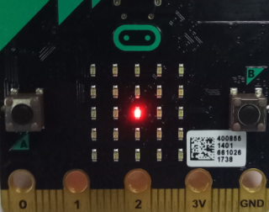
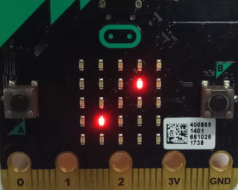
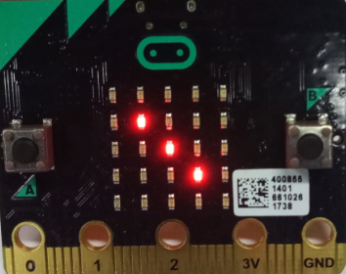
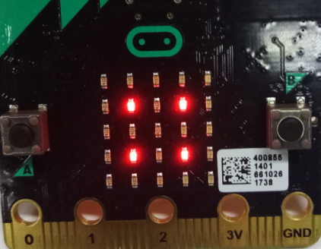
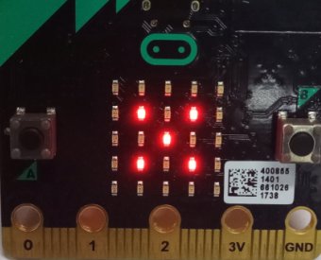
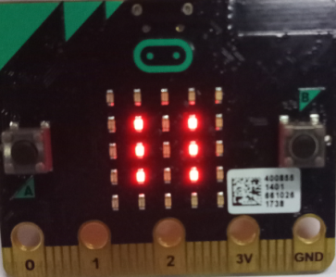
micro:bit entry video tutorial
Part 1
Learning goals
After downloading the program, shake a roll of micro:bit. There are 1-6 points randomly appearing on the dot matrix, which is exactly the same as playing the dice. You can call your buddy to play this game, see who points out relatively large
YahBoom micro:bit video tutorial

Slide 4
micro:bit entry video tutorial
Part 2
Hardware:
● 1 X Micro: bit Board
● 1 X Micro USB Cable
● 2 X AAA batteries
Preparation
Then the micro:bit is connected to the computer through USB, and the computer will pop up a U disk and click the URL in the U disk to enter the programming interface.
YahBoom micro:bit video tutorial

Slide 5
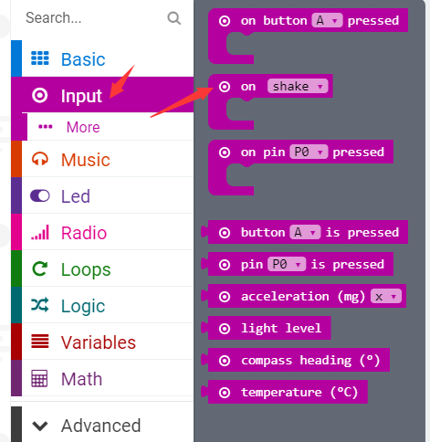
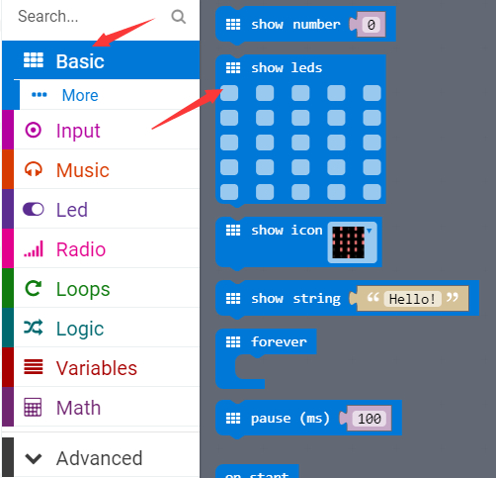
micro:bit entry video tutorial
Part 3
Search for blocks
YahBoom micro:bit video tutorial

Slide 6
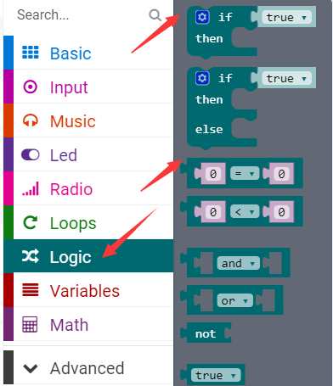
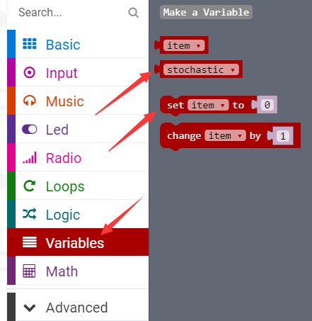
micro:bit entry video tutorial
Part 3
Search for blocks
YahBoom micro:bit video tutorial

Slide 7
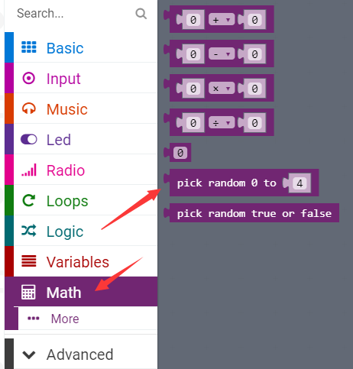
micro:bit entry video tutorial
Part 3
Search for blocks
寻找积木
YahBoom micro:bit video tutorial

Slide 8
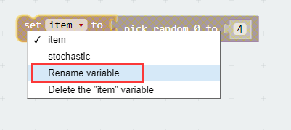

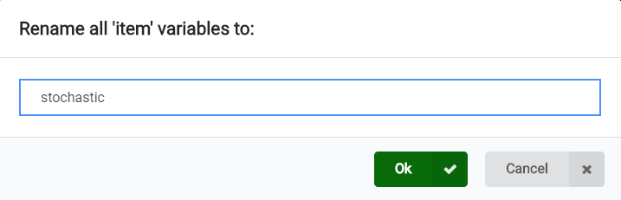
micro:bit entry video tutorial
Part 3
Search for blocks
YahBoom micro:bit video tutorial

Slide 9
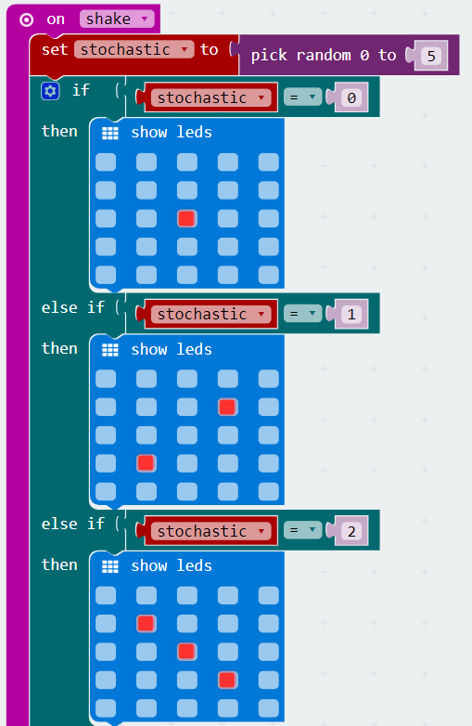
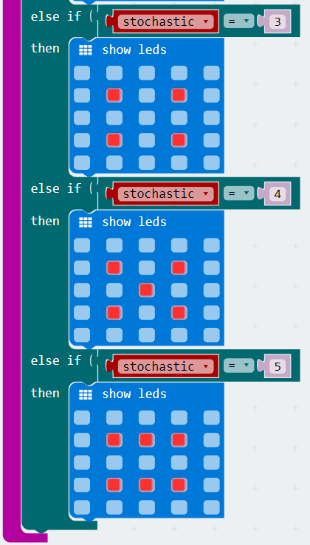
micro:bit entry video tutorial
Part 4
Combine blocks
The right blocks follow with the left
YahBoom micro:bit video tutorial

Slide 10


micro:bit entry video tutorial
Part 5
Do you learn the course today?
If you learn to do it, give yourself a top quack.
Now give you a homework assignment.
On micro:bit, we can play a melody when we shake it.
Start your little brain. Try it.
Have a try
YahBoom micro:bit video tutorial

Slide 11
micro:bit entry video tutorial
micro:bit
project
Thanks for watching！
Powered by YahBoom
YahBoom Micro:bit video tutorial

